Slide 1
Customer segmentation
Swapnita Pandey​

Slide 2
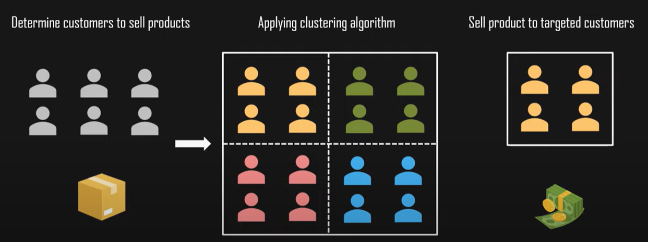
Introduction
Practice of dividing company customers into groups that reflect similarity among customers in each group.
To decide how to relate to customers in each segment to maximize the values of each customer to the business.
Process requires a thought, strategy, understanding of how to manage and group your customers and which data you will use to do this.
Figure illustrating the working of clustering

Slide 3
Problem statement
Performing K-Means Clustering to segregate customers based on the data in form of optimal clusters using Mall Customer dataset.
Process
Understanding the data
Performing elbow method to find optimal number of clusters.
Training a model using unsupervised learning algorithm (K-Means) and plotting the clusters

Slide 4
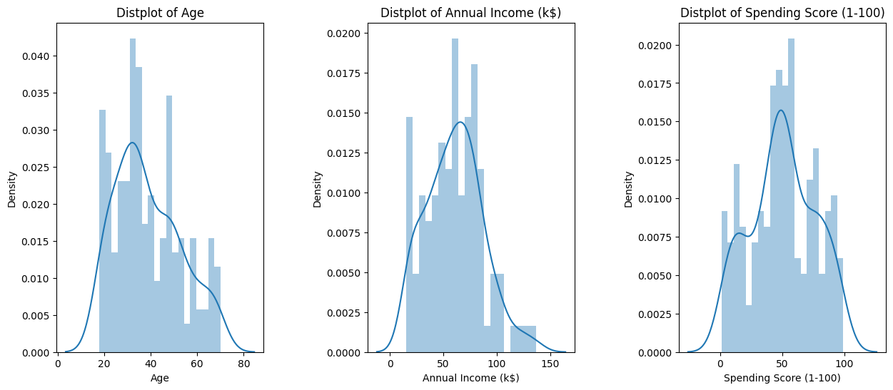
1. Understanding the data
Importing useful and required libraries.
Understanding the dataset.
Check for the NULL values.
Preparing the data for clustering.
Graph depicting density of age, annual income and spending score

Slide 5
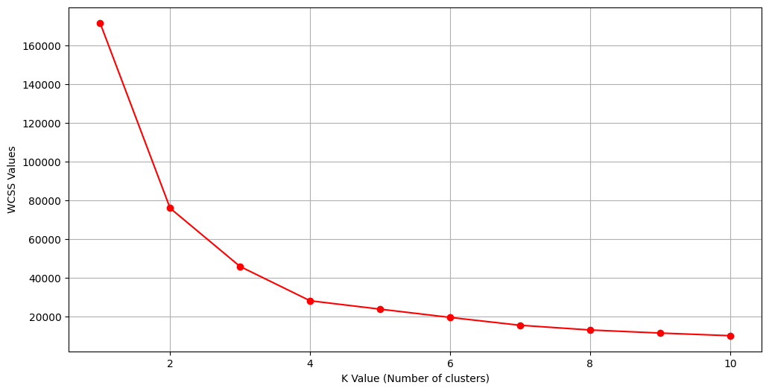
2. Performing elbow method to find optimal number of clusters
Using K-Means to iterate from 1 to 11 clusters and plotting a Elbow plot.
Deciding optimal number of clusters to be used.
(In Elbow method we draw a curve between WCSS
(Within Cluster Sum of Squares and the Number of
Clusters. The elbow point gives us the optimum number
of clusters. After the elbow point there are very slow
changes in the value of WSS. So, the elbow point value
is taken as the number of clusters.)
Elbow Plot

Slide 6
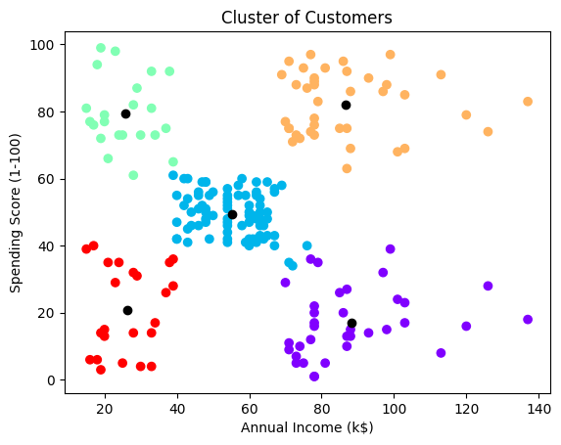
3. Training a model using unsupervised learning algorithm (K-Means) and plotting the clusters
Initializing our K-Means Model with selected optimal number of
clusters.
Plot the Clusters and gain intuitions regarding our customers.
Analysis of annual income and spending score using scatter plot

Slide 7
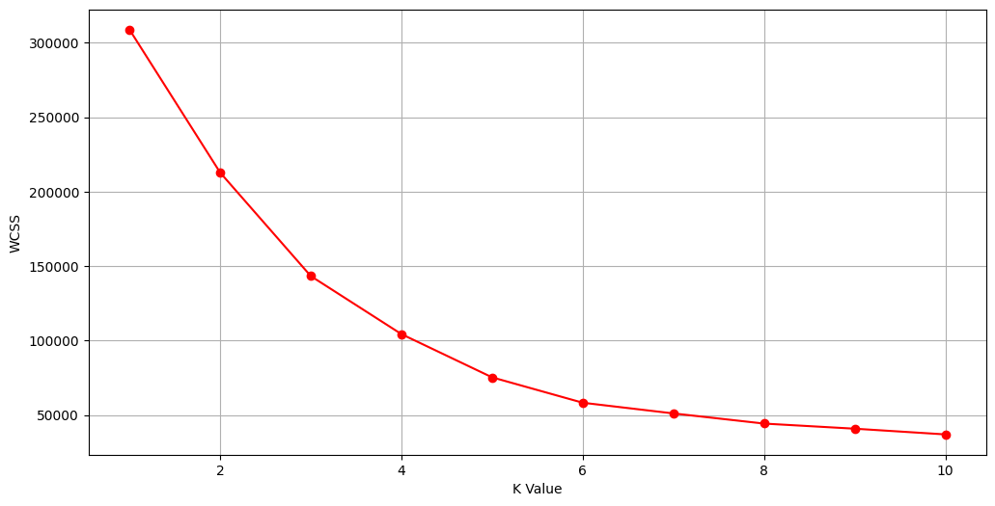
Results and discussion
From this Elbow plot we can observe that the point of inflection is at K-Value = 5.
After K-Value = 5, there is a very slow change in the value of WCSS (Within Cluster Sum of Squares)
So, the elbow point value, i.e., K-Value = 5 is taken as the Elbow point which indicates the
optimal number of clusters to be formed.
Elbow Plot

Slide 8
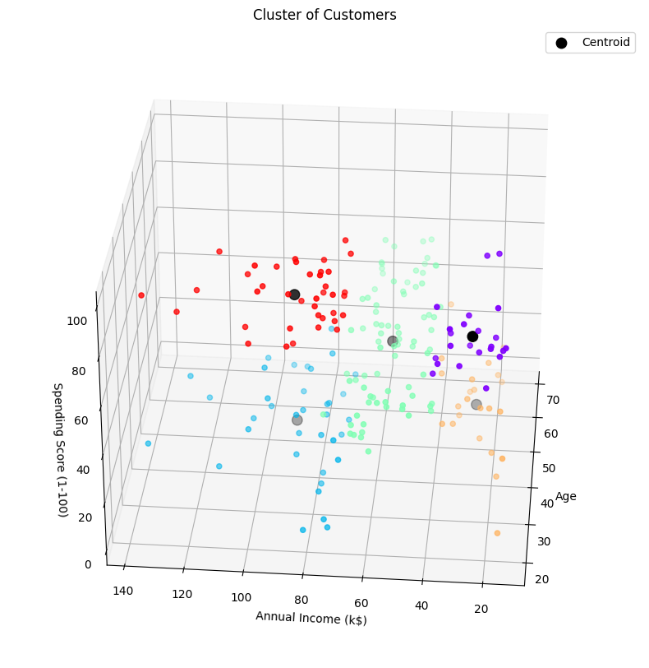
Results and discussion
From the scatter plot, we can observe that some of the customers have less salary but more spending score.
While some are less in their age but have more spending score.
Such customers are not reliable for selling products.
Analysis of age, annual income, and spending score using scatter plot

Slide 9
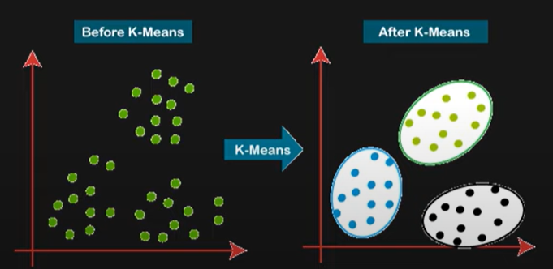
Results and discussion
Target audience cluster should be the one that includes maximum number of customers with decent salary, medium age group, and spending is also well.
This is the most important intuitions which is extracted by a lot of companies to target their customers based on the available data.
So, the center cluster includes the target audience to which the products should be sold first.
Figure depicting working of K-Means algorithm.

Slide 10
Conclusion and future work
K-Means algorithm can be used to divide unlabeled datasets into k predefined distinct groups.
One of the ways of applying K-Means is Elbow method.
This type of segmentation can be used in many fields such as for brand awareness, price optimization, document segmentation and much more.
The project is an analysis of the technique of customer segmentation which is the most important intuitions which is extracted by a lot of companies to target their customers based on the available data.
To make the project more user-friendly and applicable in daily life a front-end may be added to the project in the future.

Slide 11
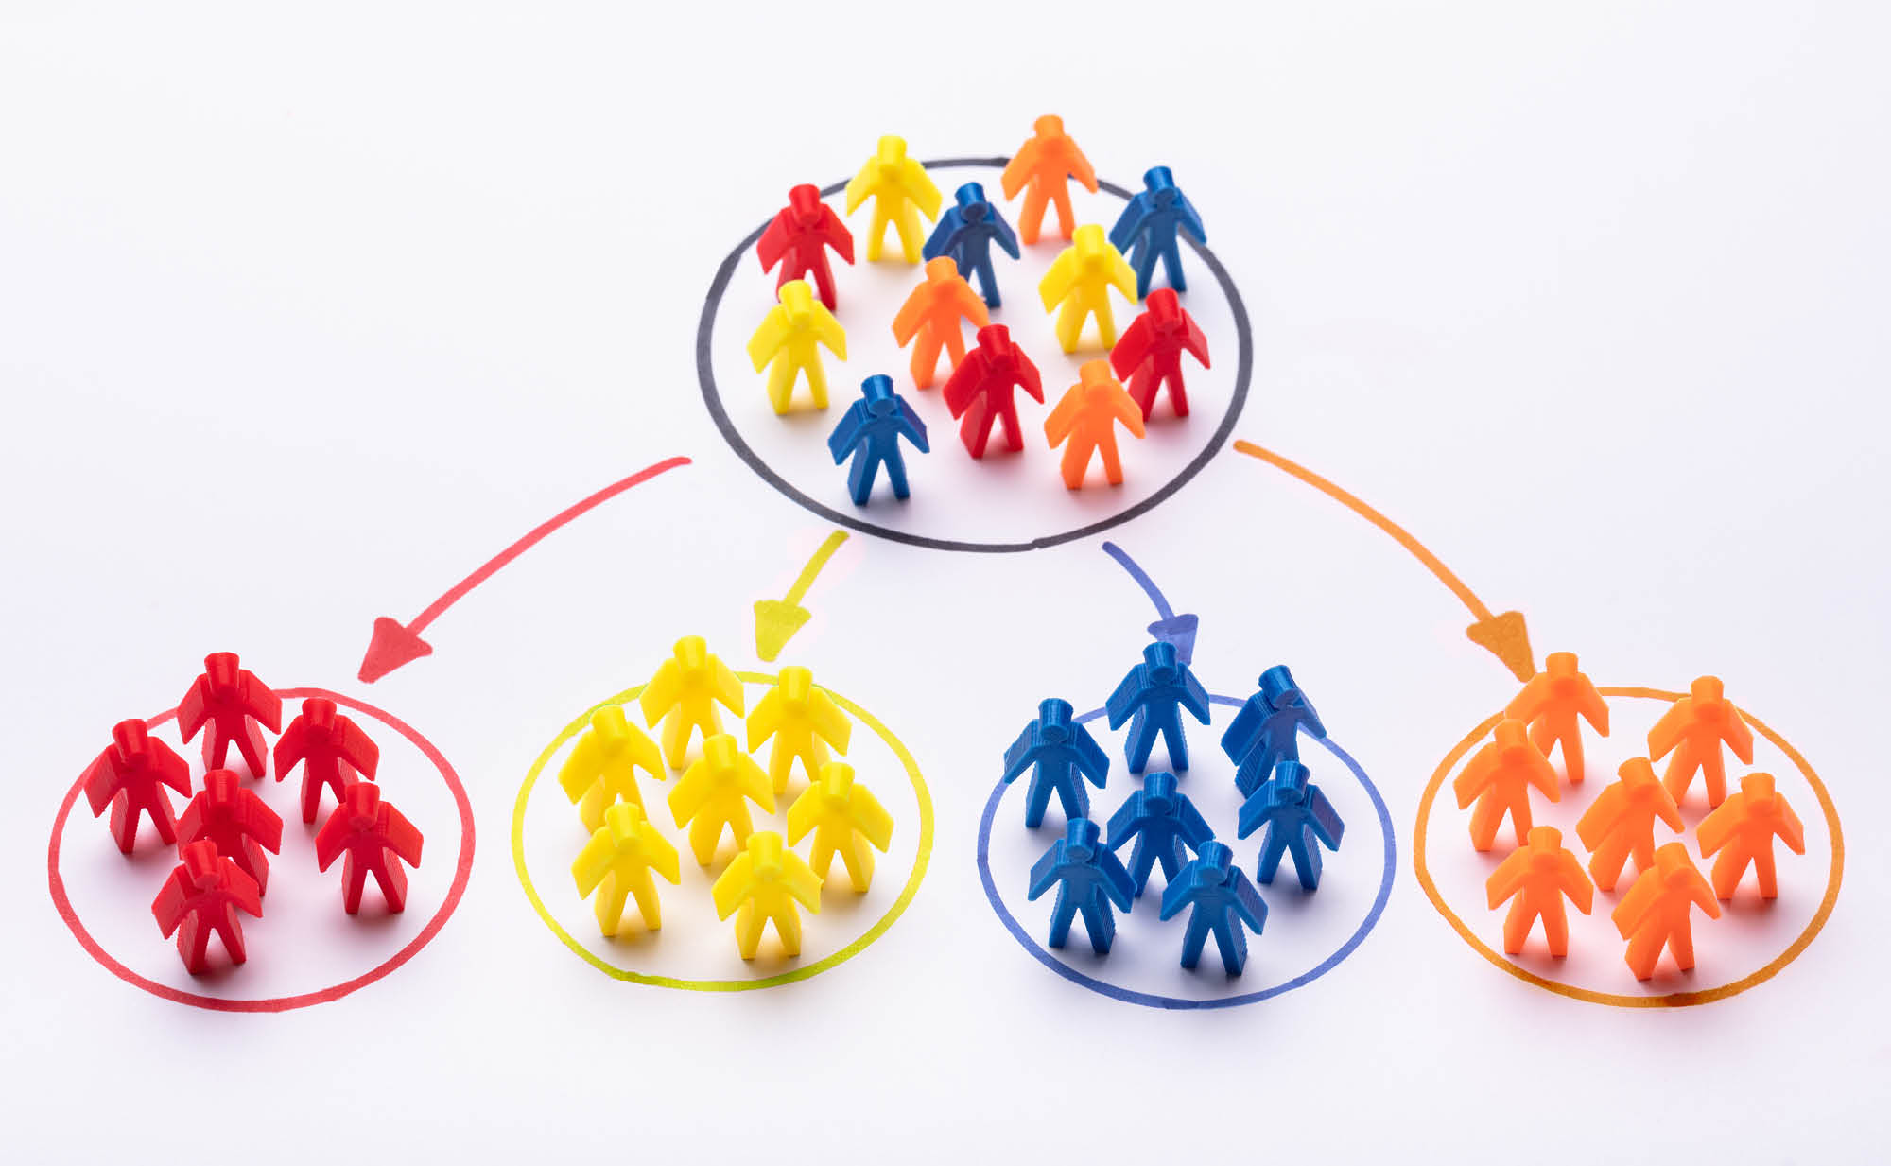
THANK YOU !

